Slide 1

MAT205: Abstract Algebra II
14. Galois Theory I
Ma, Jia-Jun

Slide 2

Review of basic facts
Conjugate elements
automorphism of $E$
Fixed field $E_{S} ,$ for $S⊂Aut(E)$
index and splitting field

Slide 3

Review of basic facts
index and degree
Assume $E$ is a finite separable splitting field.
size of Galois group = index = degree

Slide 4
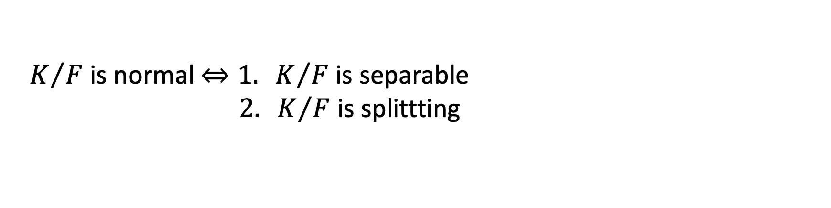
Finite Normal extension / Galois extension.
$K/F$ is normal $⇔1. K/F$ is separable
$2. K/F$ is splittting

Slide 5
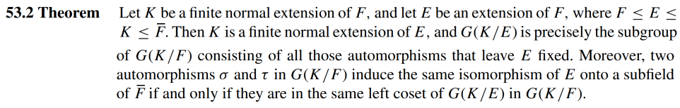
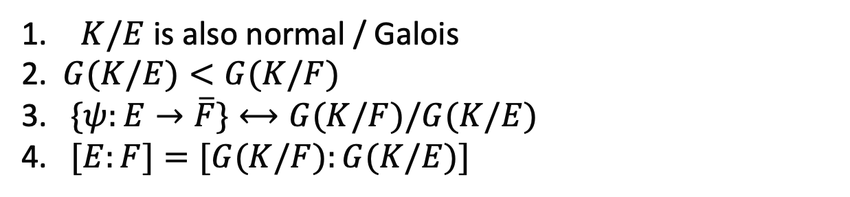
$K/E$ is also normal / Galois
$G(K/E)<G(K/F)$
$\{ψ:E→\overline{F}\}⟷G(K/F)/G(K/E)$
$[E:F]=[G(K/F):G(K/E)]$

Slide 6
$K/F$ finite Galois $⇒∀ F≤E≤K,$ $K/E$ is finite Galois

Slide 7
$K/F$ finite Galois $⇒∀ F≤E≤K,$ $G\left(K/E\right)≤G(K/F)$

Slide 8
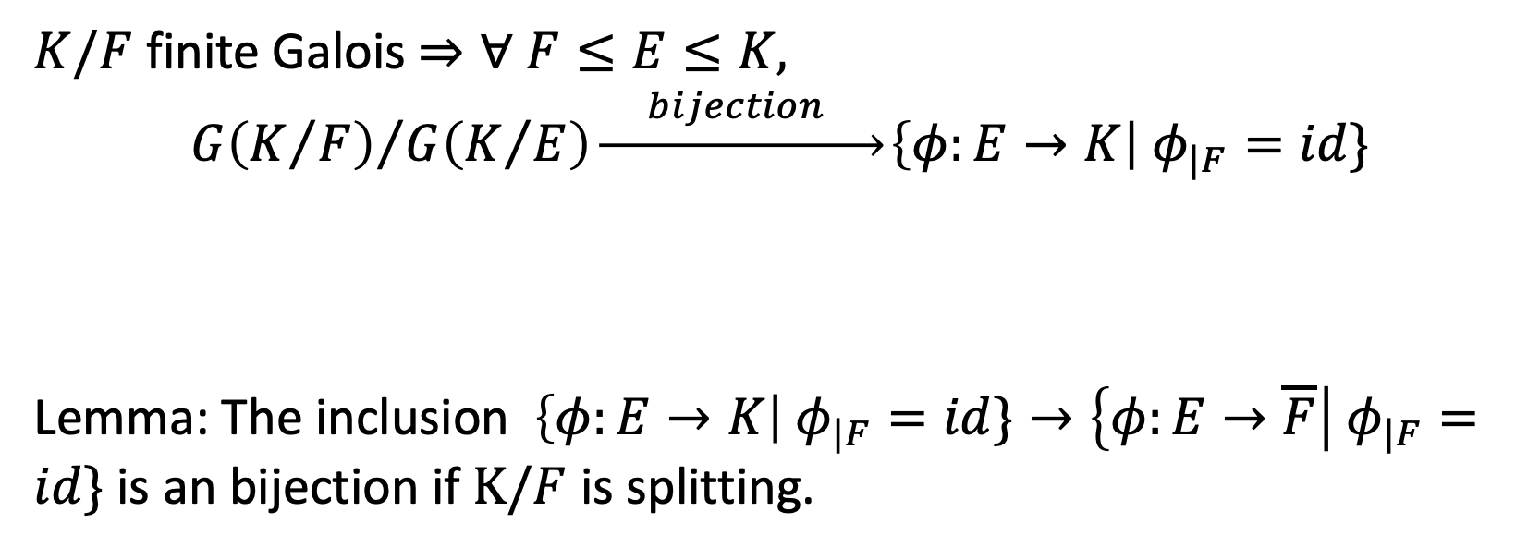
$K/F$ finite Galois $⇒∀ F≤E≤K,$
$${G\left(K/F\right)}/{G\left(K/E\right)}\underset{→}{ bijection }\left\{φ:E→K\right| φ_{|F}=id\}$$
Lemma: The inclusion $\left\{φ:E→K\right| φ_{|F}=id\}→\left\{φ:E→\overline{F}\right| φ_{|F}=id\}$ is an bijection if $K/F$ is splitting.

Slide 9
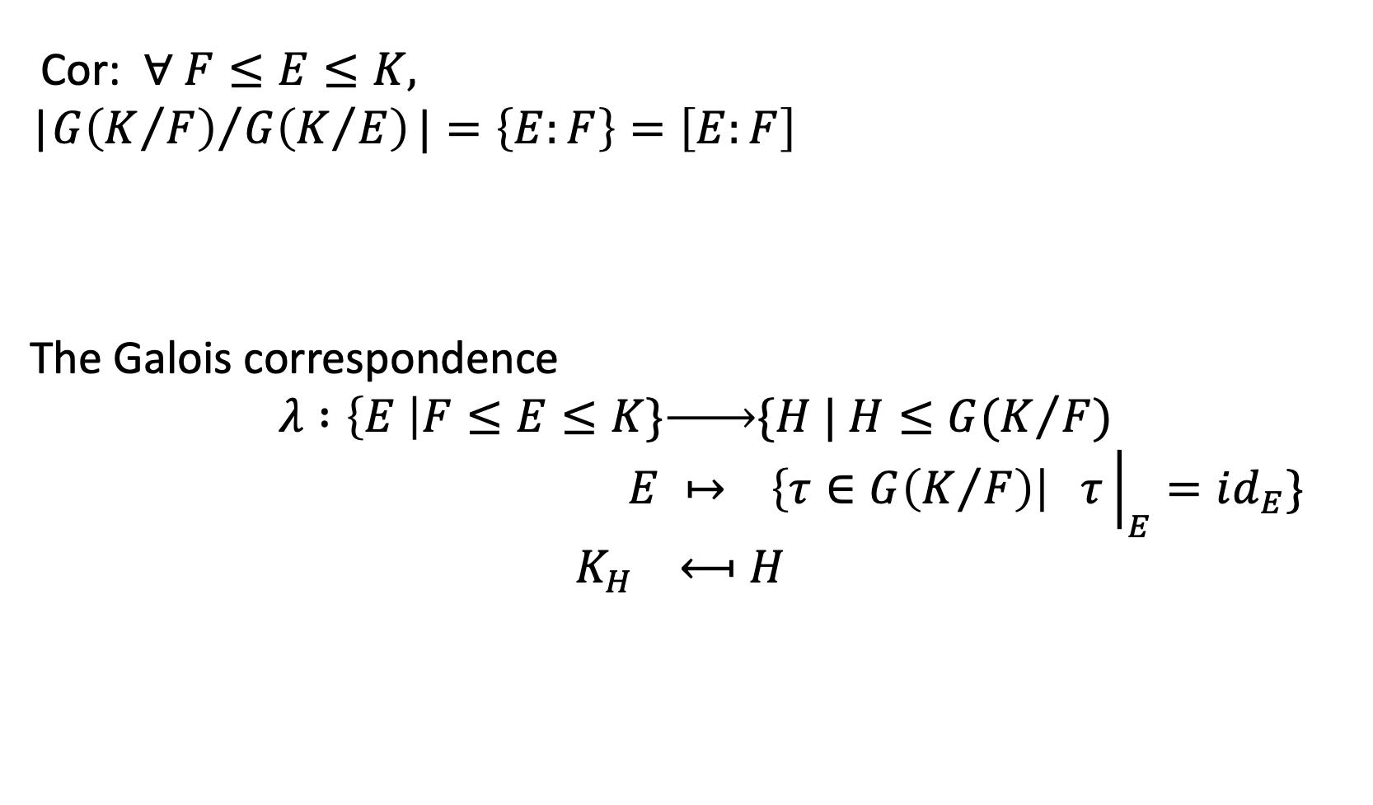
Cor: $∀ F≤E≤K,$
|${G\left(K/F\right)}/{G\left(K/E\right)}|=\left\{E:F\right\}=\left[E:F\right]$
The Galois correspondence
$$λ :\left\{E \right|F≤E≤K\}\underset{→}{ }\{H | H≤G(K/F)$$
$$E ↦ \left\{τ∈G\left(K/F\right)\right| τ{\left.​\right|}_{E}=id_{E}\}$$
$$K_{H} ⟻H$$

Slide 10
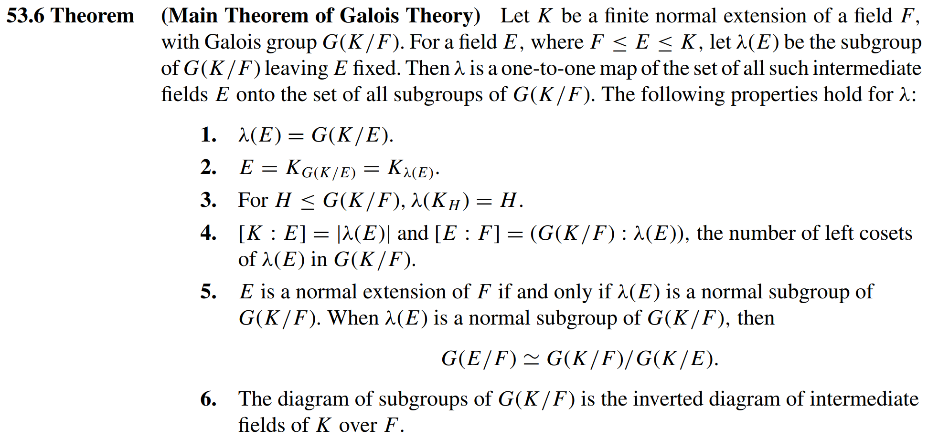

Slide 11
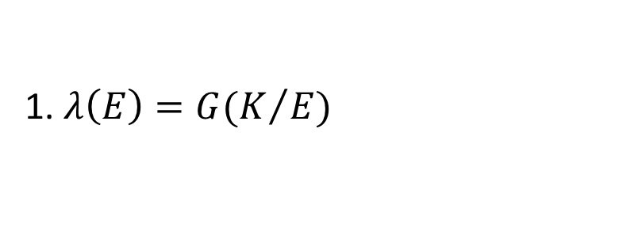
Proof of the Main Theorem
1. $λ\left(E\right)=G(K/E)$

Slide 12
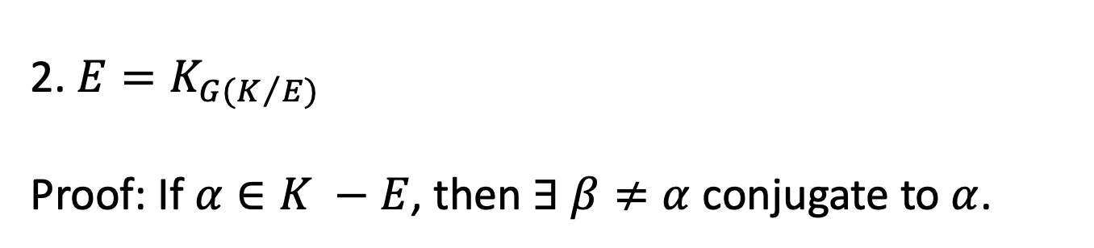
2. $E=K_{G(K/E)}$
Proof: If $α∈K −E$, then $∃ β≠α$ conjugate to $α$.

Slide 13
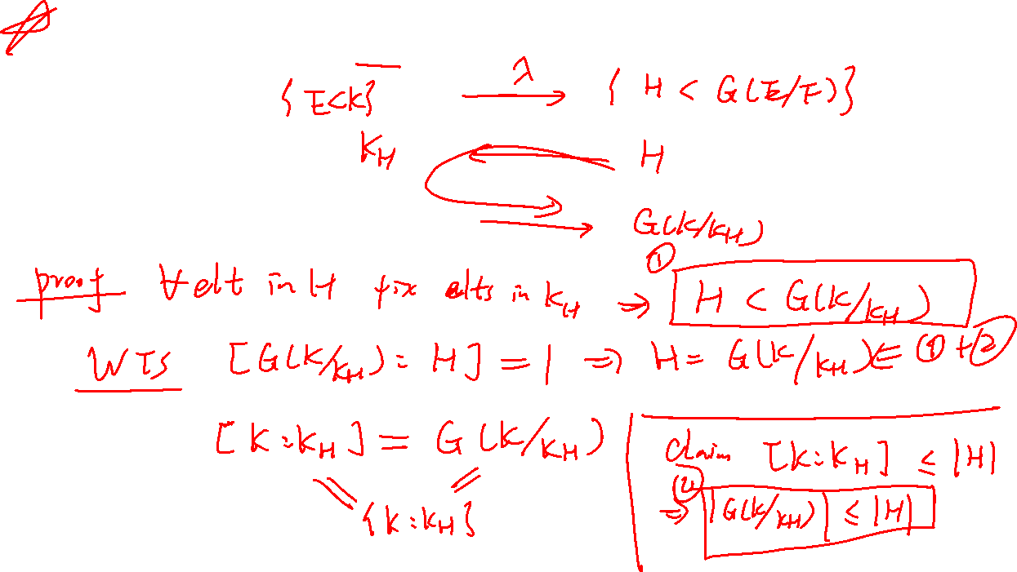



3. $∀ H<G\left(K/F\right), G(K/{K_{H}})=H$

Slide 14
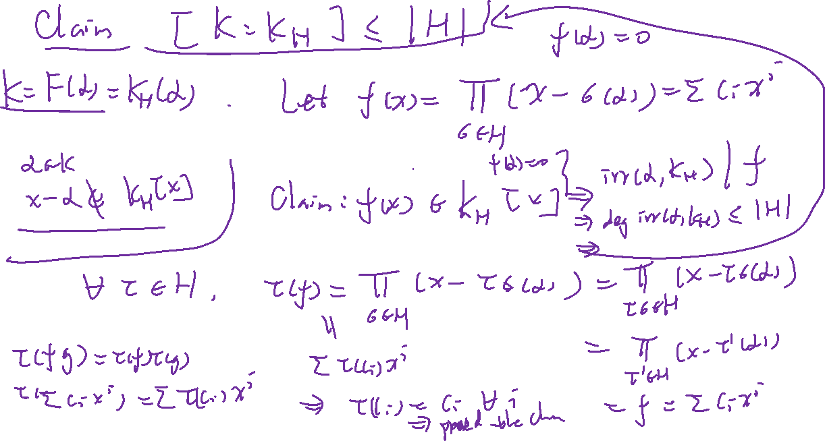

Slide 15
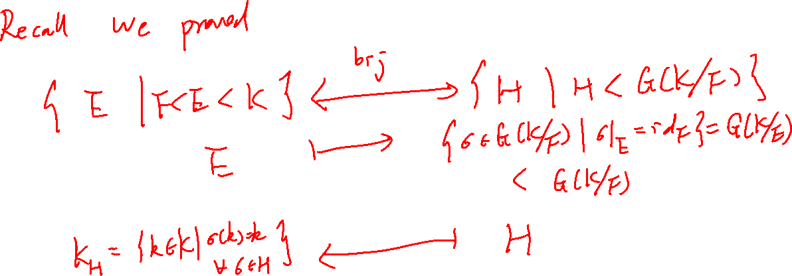

Slide 16
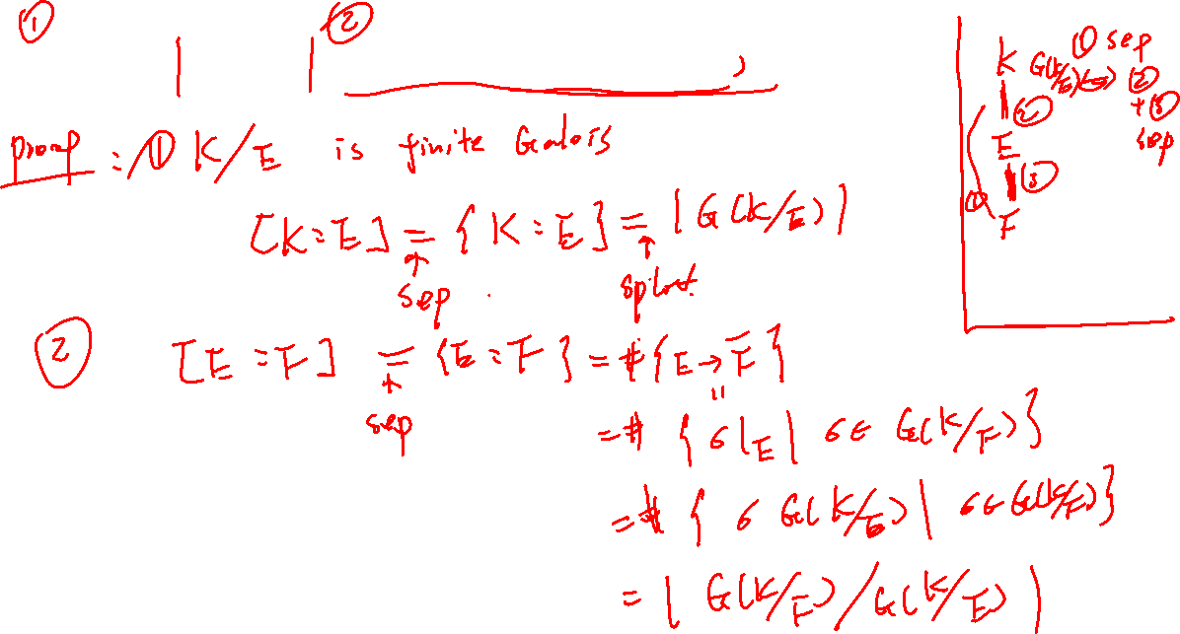
4. $\left[K:E\right]=G\left(K/E\right), \left[E:F\right]=[G\left(K/F\right):G(E/F]$

Slide 17
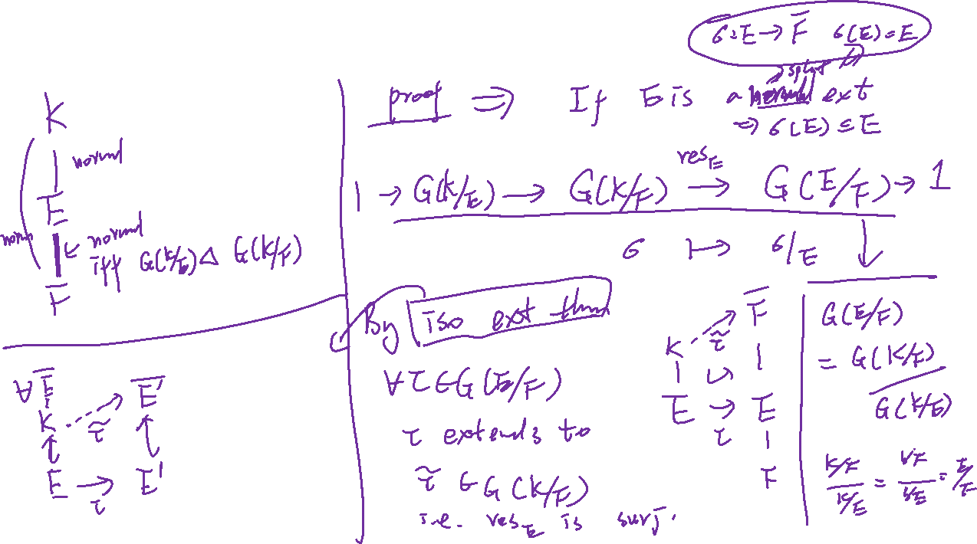
5. $E$ is a normal extension of $F$ $⇔G\left(K/E\right)⊲G\left(K/F\right)$.

Slide 18
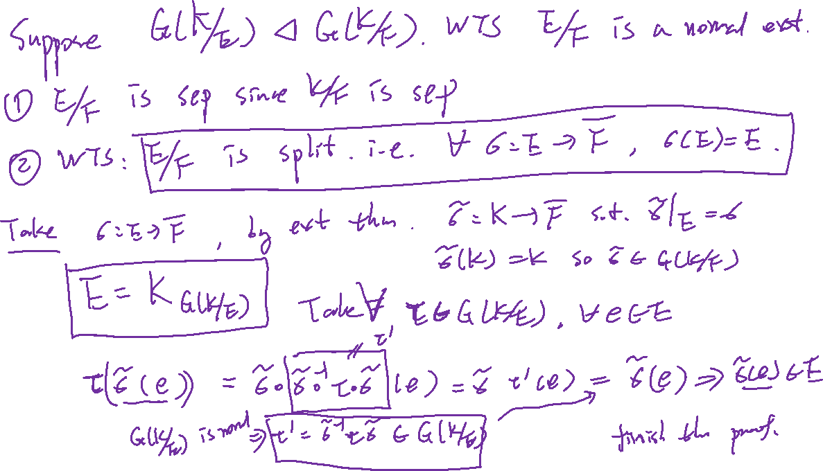

Slide 19
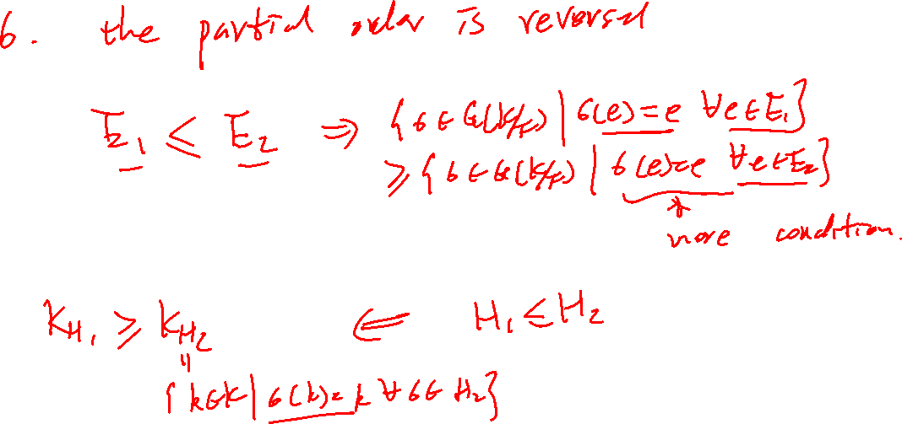

Slide 20
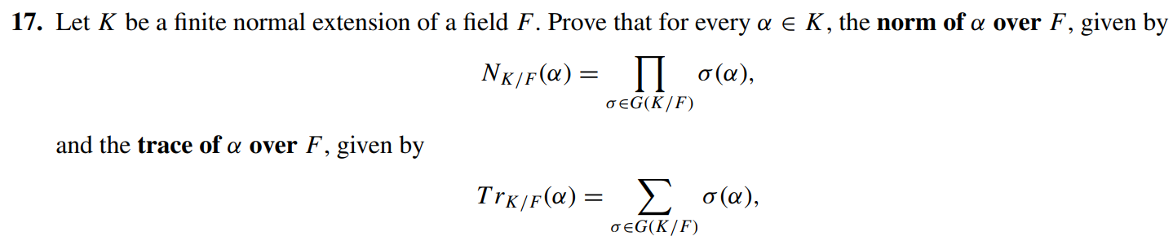
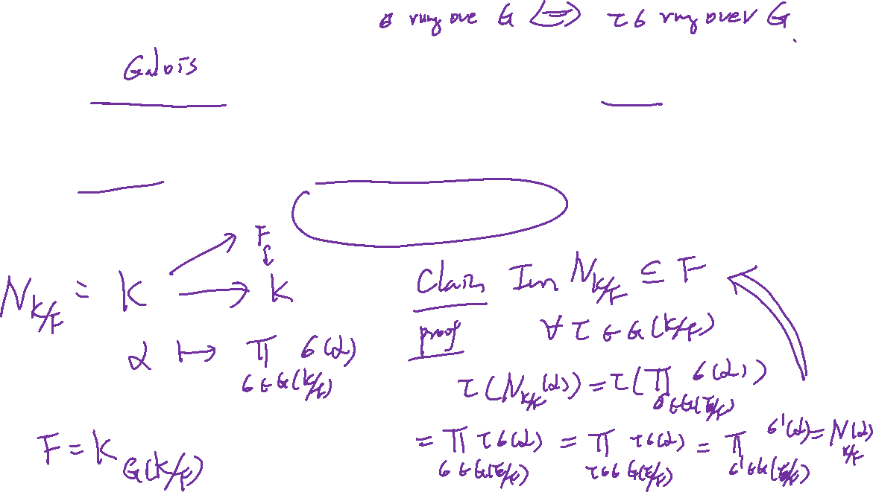
Norm and Trace

Slide 21
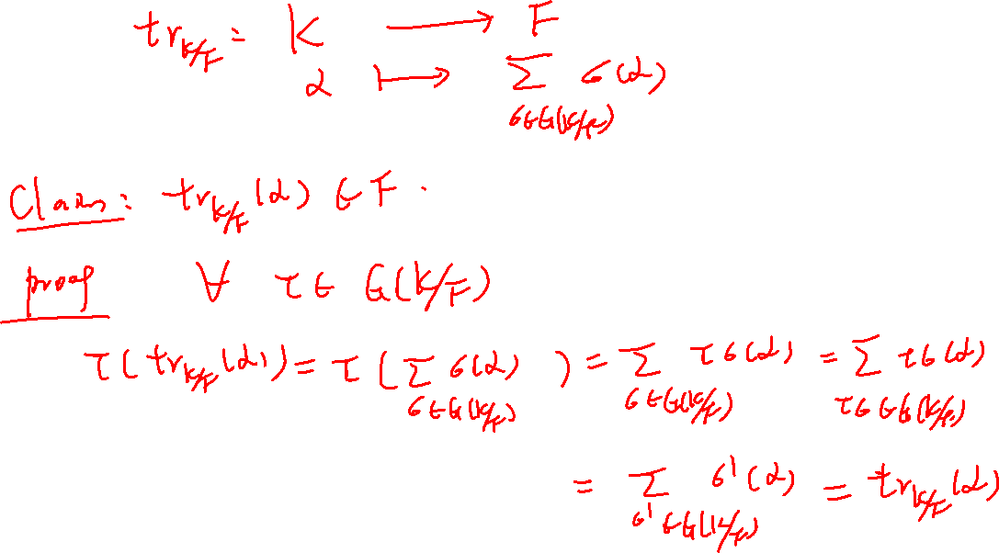

Slide 22
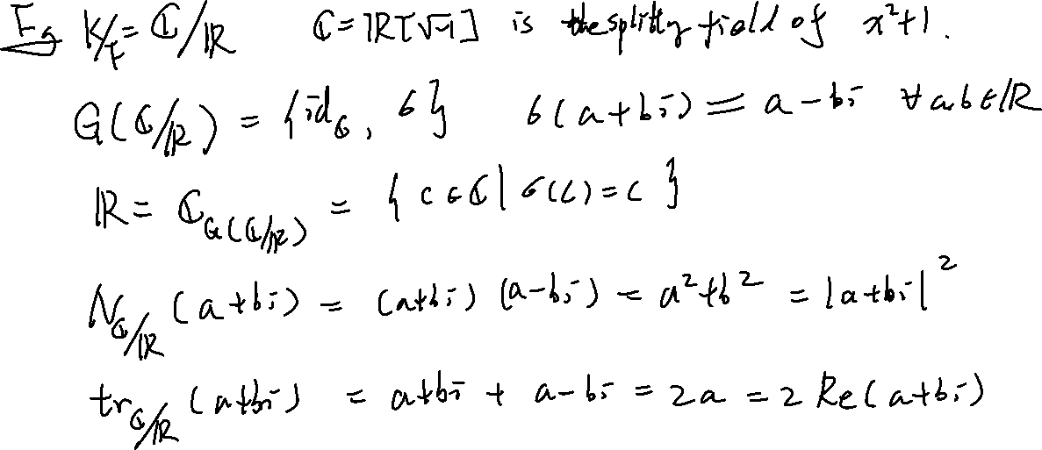

Slide 23
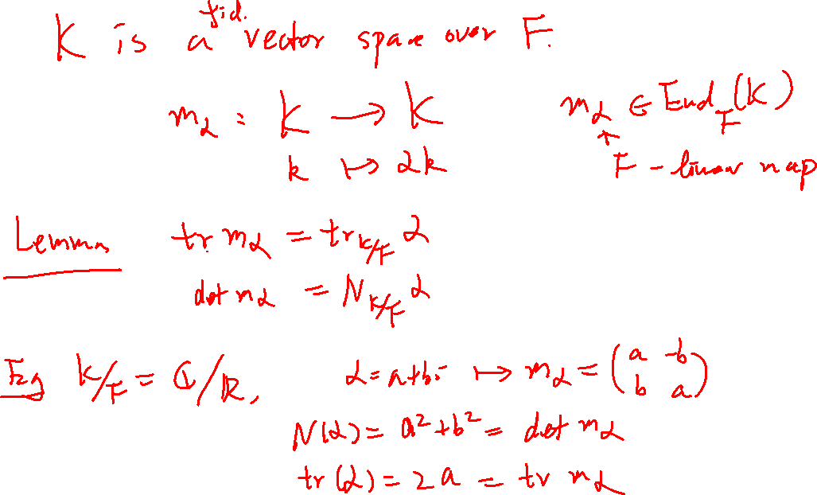

Slide 24
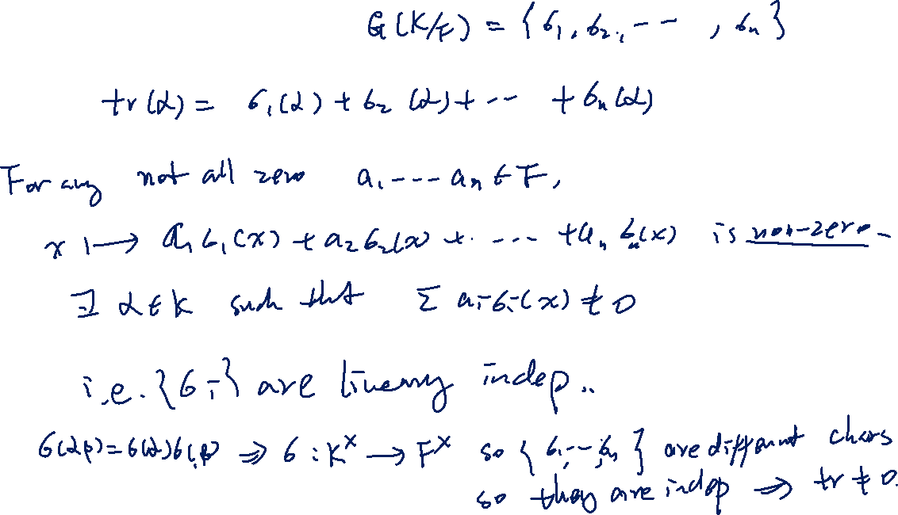
The trace map is non-zero

Slide 25
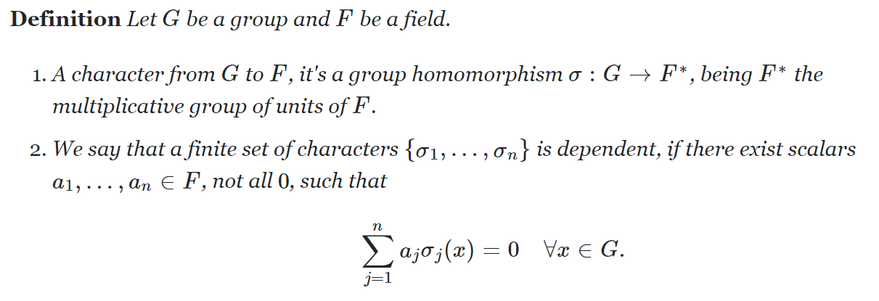
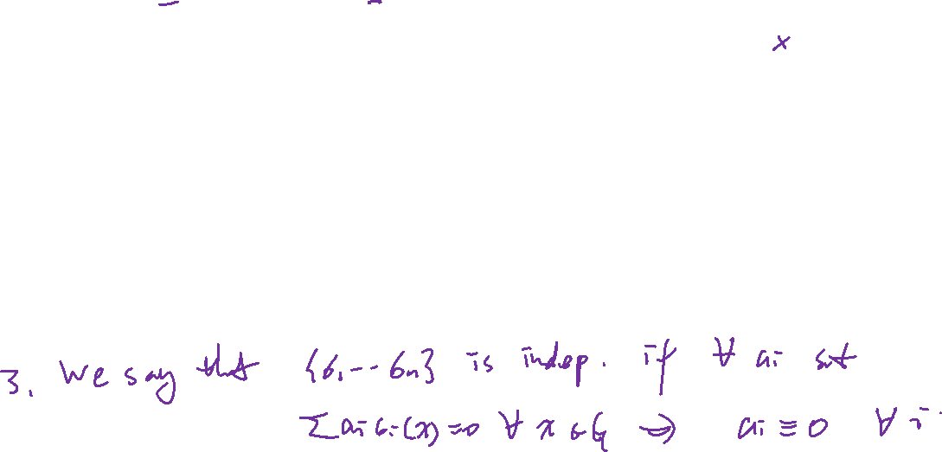
The trace map is non-zero

Slide 26

Proof. Proceed by induction.

Slide 27

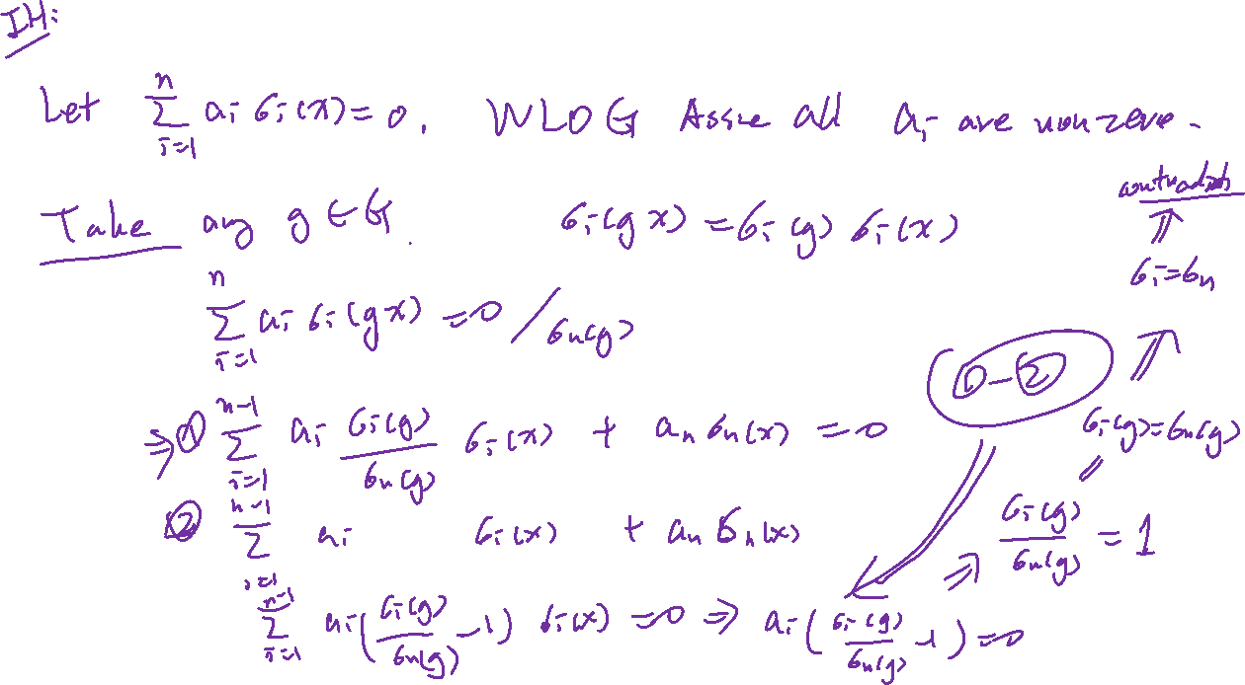
Suppose the theorem holds for any $n−1$ distinct characters:

Slide 28
